Slide 1


Практикум на ЭВМ.
Программирование под Android
Занятие 3

Slide 2
LayoutInflater

Slide 3
LayoutInflater
Создаёт иерархию объектов интерфейса из файла ресурса.
LayoutInflater inflater = (LayoutInflater)context.
getSystemService(Context.LAYOUT_INFLATER_SERVICE);
View view = inflater.inflate(R.layout.item_list, null, false);

Slide 4
Списки

Slide 5
ScrollView
Данные не помещаются на экран
Только 1 дочерний элемент

Slide 6
ScrollView
<ScrollView android:layout_width="match_parent" android:layout_height="match_parent"> <LinearLayout android:layout_width="match_parent" android:layout_height="wrap_content" android:orientation="vertical"> <TextView android:layout_width="wrap_content" android:layout_height="wrap_content" /> <TextView android:layout_width="wrap_content" android:layout_height="wrap_content" /> </LinearLayout> </ScrollView>

Slide 7
ScrollView
group = (ViewGroup)findViewById(R.id.root_container);
for (int i = 0; i < 10_000; i++) { TextView tv = new TextView(this); tv.setText("Item #" + i);
group.addView(tv, new ViewGroup.LayoutParams( ViewGroup.LayoutParams.MATCH_PARENT, 80)); }

Slide 8
ScrollView
Много данных:
Медленно
Много ОЗУ

Slide 9
RecyclerView
Пришёл на смену ListView
build.gradle:
dependencies { compile "com.android.support:recyclerview-v7:24.2.1" }

Slide 10
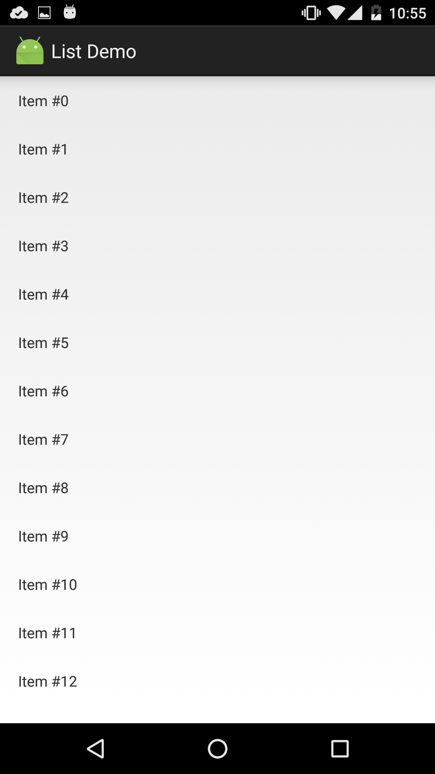
Adapter
Adapter
(index -> view)
Данные

Slide 11
Adapter
public static abstract class Adapter<VH extends ViewHolder>
private class SimpleRecyclerAdapter extends
RecyclerView.Adapter<SimpleRecyclerAdapter.ViewHolder>

Slide 12

ViewHolder
Настройка одной ячейки
public void bindView(View view, int position) { TextView name = view.findViewById(R.id.name); TextView additional = view.findViewById(R.id.additional); ImageView image = view.findViewById(R.id.image); ... }

Slide 13
ViewHolder
class ViewHolder extends RecyclerView.ViewHolder { final TextView firstLine; final TextView secondLine; public ViewHolder(View itemView) { super(itemView); firstLine = (TextView)itemView.findViewById(R.id.fist_line); secondLine = (TextView)itemView.findViewById(R.id.second_line); } }

Slide 14
Переиспользование View
@Override public ViewHolder onCreateViewHolder(
ViewGroup parent, int viewType) { return new ViewHolder(
li.inflate(R.layout.item_list, parent, false)); }

Slide 15
Переиспользование View
@Override public void onBindViewHolder(ViewHolder holder, int position) { String str = items.get(position);
holder.firstLine.setText(str + " first"); holder.secondLine.setText(str + " second"); }

Slide 16
Обработка нажатий
public ViewHolder(View itemView) { super(itemView); // ... itemView.setOnClickListener(clickListener); }
@Override public void onClick(View v) { ViewHolder holder =
(ViewHolder)recyclerView.getChildViewHolder(v);
int position = recyclerView.getAdapterPositionFor(holder); }

Slide 17
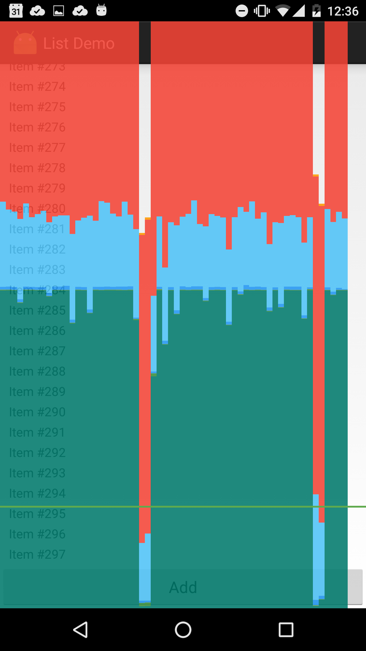
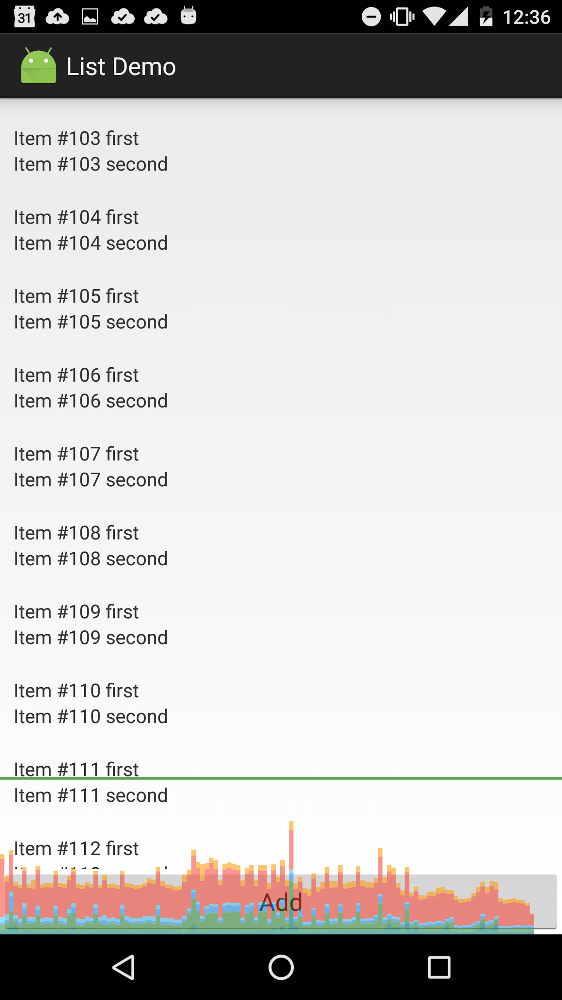
Сравнение

Slide 18
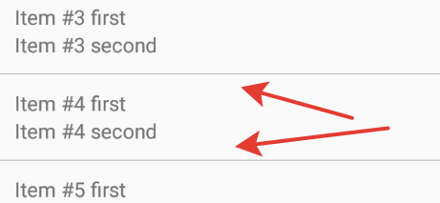
ItemDecorator

Slide 19
ItemDecorator
public final class DividerItemDecorator extends RecyclerView.ItemDecoration { @Override public void getItemOffsets(Rect outRect, View view,
RecyclerView parent, RecyclerView.State state) { ... } @Override public void onDrawOver(Canvas c, RecyclerView parent,
RecyclerView.State state) { ... } }
recyclerView.addItemDecoration(new DividerItemDecorator(this));

Slide 20
LayoutManager
LinearLayoutManager
GridLayoutManager
recyclerView.setLayoutManager(new LinearLayoutManager(this));

Slide 21
Вопросы?

